Slide 1
2022 World Investor Week /
World Financial Planning Day
Copyright © 2022 Financial Planning Standards Board

Slide 2
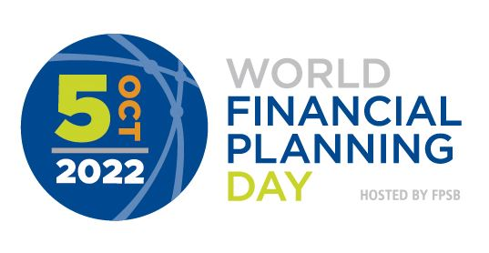
Live your today. Plan your tomorrow ™

Slide 3
Live your today. Plan your tomorrow ™

Slide 4
Live your today. Plan your tomorrow ™

Slide 5
Copyright © 2022 Financial Planning Standards Board

