Slide 1
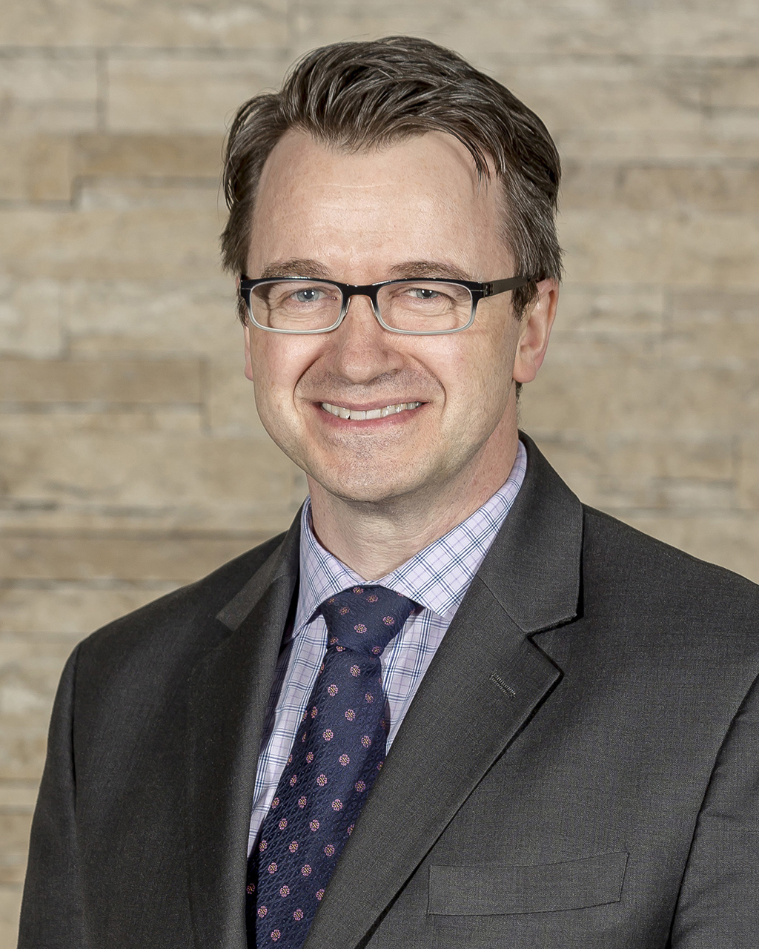
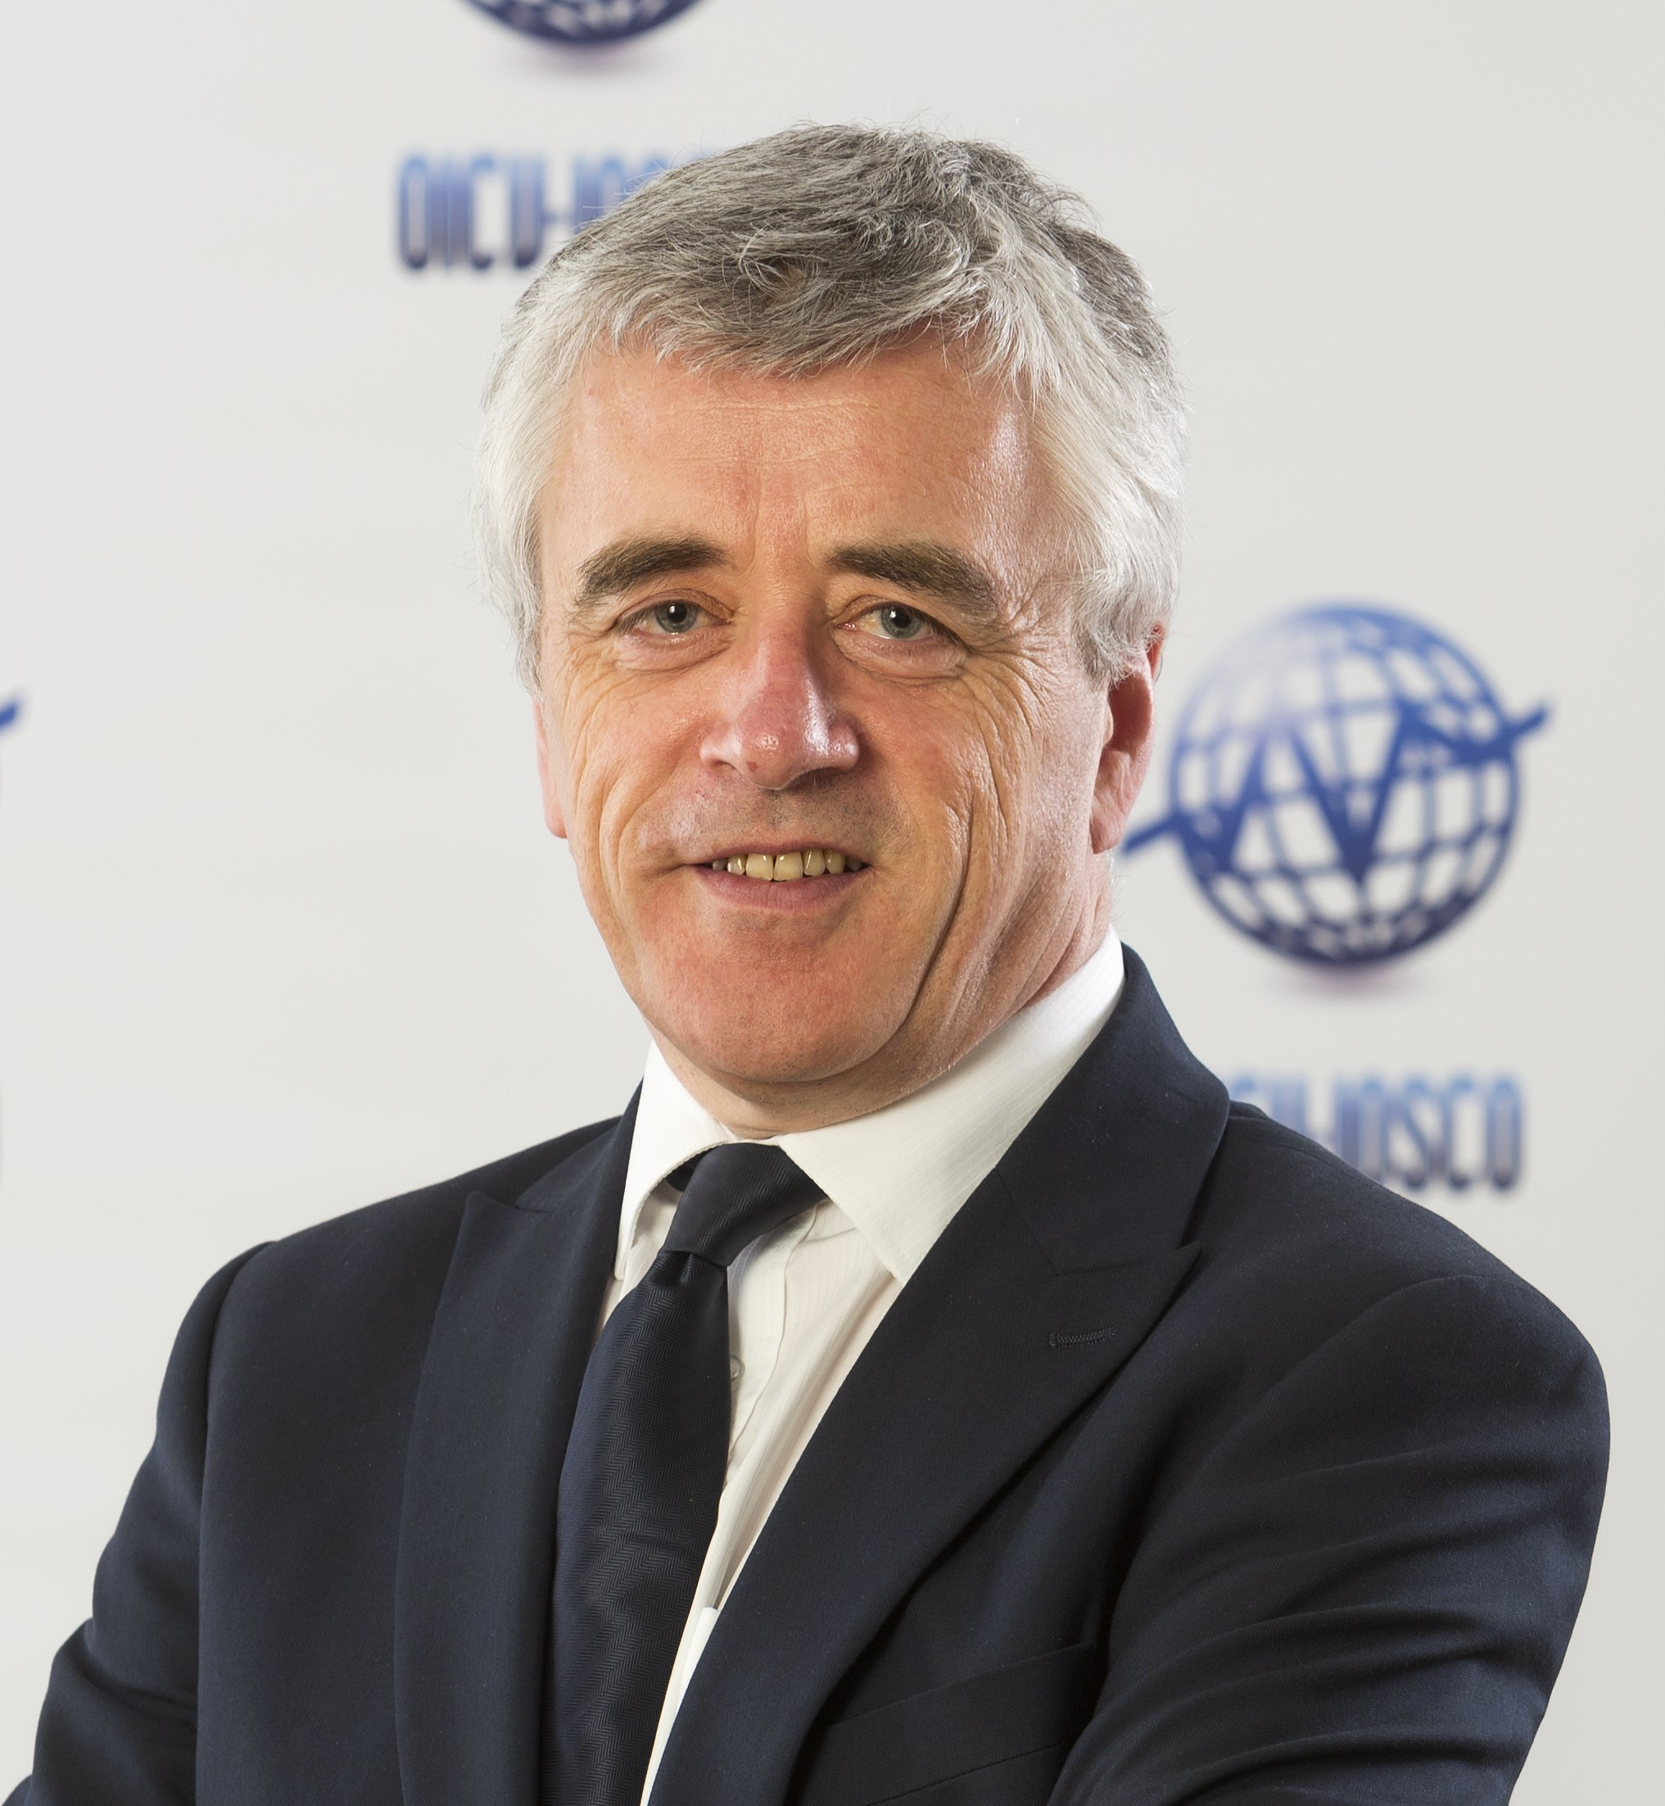
Fireside Chat: FPSB & IOSCO
Noel Maye
FPSB CEO
Martin Moloney
IOSCO Secretary General
Copyright © 2022 Financial Planning Standards Board

Slide 2
Fireside Chat: Invite to Feature on Social Media
FPSB invites Affiliates to feature the FPSB / IOSCO Fireside Chat via social media
Video is available on FPSB’s YouTube Channel for Affiliates to showcase on their respective social media platforms on World Financial Planning Day
Video Link: https://bit.ly/FiresideChat-FPSB-IOSCO

Slide 3
Fireside Chat: Financial Planning Community
This 5 October, join IOSCO Secretary General Martin Moloney and FPSB CEO Noel Maye for a discussion on how those in the financial planning profession can support investor education and consumer protection efforts. Tune in here on 5 Oct to see the on-demand discussion.
#WFPD2022 #IOSCOWIW2022
Tag FPSB at:
LinkedIn: @Financial Planning Standards Board Ltd.
Facebook: @Financial Planning Standards Board Ltd.
Twitter: @FPSB
Instagram: @fpsb_global

Slide 4
Fireside Chat: Investor Risks
This World Financial Planning Day, 5 October, join a Fireside Chat with IOSCO Secretary General Martin Moloney and FPSB CEO Noel Maye to learn more about investor risks and how those in the financial planning community can help protect consumers. Tune in here on 5 Oct to see the on-demand discussion.
#WFPD2022 #IOSCOWIW2022
Tag FPSB at:
LinkedIn: @Financial Planning Standards Board Ltd.
Facebook: @Financial Planning Standards Board Ltd.
Twitter: @FPSB
Instagram: @fpsb_global

Slide 5
Fireside Chat: World Financial Planning Day
World Financial Planning Day is here! Join IOSCO Secretary General Martin Moloney and FPSB CEO Noel Maye as they discuss how those in the financial planning profession are supporting financial education and consumer protection efforts so you can Live Your Today, Plan Your Tomorrow. Tune in now on-demand: https://bit.ly/FiresideChat-FPSB-IOSCO #WFPD2022 #IOSCOWIW2022
Tag FPSB at:
LinkedIn: @Financial Planning Standards Board Ltd.
Facebook: @Financial Planning Standards Board Ltd.
Twitter: @FPSB
Instagram: @fpsb_global

