Slide 1
Value of Financial Planning
Video Segments
Copyright © 2023 Financial Planning Standards Board

Slide 2
Video: Value of Financial Planning
See how the global community of CERTIFIED FINANCIAL PLANNER professionals help people around the world stay on track with their financial lives. https://bit.ly/3lxuMBg #WFPD2023 #IOSCOWIW2023 #CFP #financialplanning
Embed Code
Tag FPSB at:
LinkedIn: @Financial Planning Standards Board Ltd.
Facebook: @Financial Planning Standards Board Ltd.
Twitter: @FPSB
Instagram: @fpsb_global
Video Link: https://bit.ly/3lxuMBg (1:30 seconds)

Slide 3
Video Segment: It All Begins With a Plan
It all begins with a plan! CFP professionals around the world can help you reach your financial goals. https://bit.ly/3lxuMBg #WFPD2023 #IOSCOWIW2023 #CFP #financialplanning
Tag FPSB at:
LinkedIn: @Financial Planning Standards Board Ltd.
Facebook: @Financial Planning Standards Board Ltd.
Twitter: @FPSB
Instagram: @fpsb_global
Video Link: https://bit.ly/3OoVaJO (16 seconds)

Slide 4
Video Segment: A Roadmap To Manage It All
Financial planning is the process of developing strategies to manage multiple aspects of your financial situation to help achieve your life goals. https://bit.ly/3w1rEBG #WFPD2023 #IOSCOWIW2023 #CFP #financialplanning
Tag FPSB at:
LinkedIn: @Financial Planning Standards Board Ltd.
Facebook: @Financial Planning Standards Board Ltd.
Twitter: @FPSB
Instagram: @fpsb_global
Video Link: https://bit.ly/3A8tjt5 (13 seconds)

Slide 5
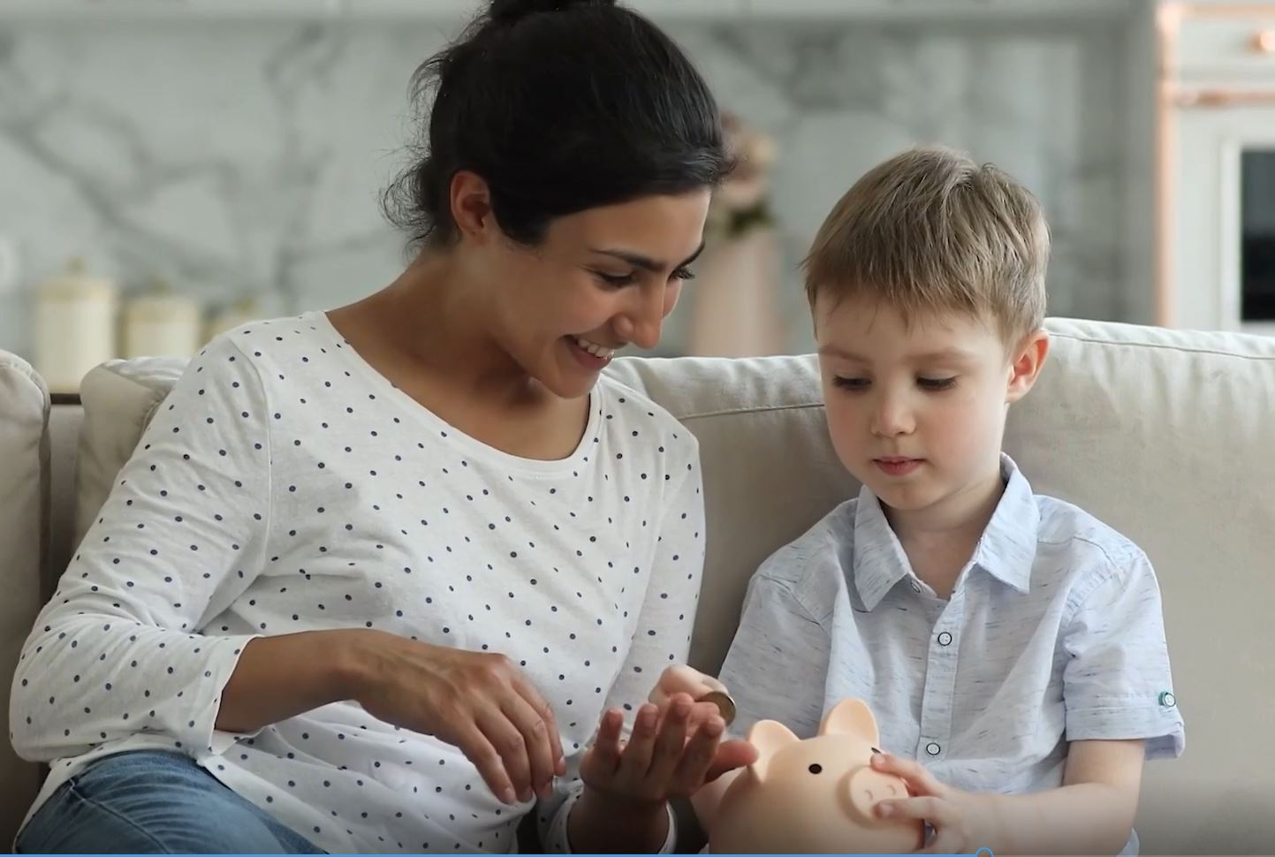
Video Segment: A Roadmap To Manage It All
Financial planning is the process of developing strategies to manage multiple aspects of your financial situation to help achieve your life goals. https://bit.ly/3w1rEBG #WFPD2023 #IOSCOWIW2023 #CFP #financialplanning
Tag FPSB at:
LinkedIn: @Financial Planning Standards Board Ltd.
Facebook: @Financial Planning Standards Board Ltd.
Twitter: @FPSB
Instagram: @fpsb_global
Video Link: https://bit.ly/3niccNF (11 seconds)

Slide 6
Video Segment: Committed to Global Standards
The global community of CERTIFIED FINANCIAL PLANNER professionals help people to stay on track with their financial lives. https://bit.ly/3spMdqG #WFPD2023 #IOSCOWIW2023 #CFP #financialplanning
Tag FPSB at:
LinkedIn: @Financial Planning Standards Board Ltd.
Facebook: @Financial Planning Standards Board Ltd.
Twitter: @FPSB
Instagram: @fpsb_global
Video Link: https://bit.ly/3QKx7qh (16 seconds)

Slide 7
Video Segment: Be Prepared. Be Confident.
People who work with a financial planner, particularly those who work with a CFP professional, can be better prepared for financial opportunities that life brings. worldfpday.org #WFPD2023 #IOSCOWIW2023 #CFP #financialplanning
Tag FPSB at:
LinkedIn: @Financial Planning Standards Board Ltd.
Facebook: @Financial Planning Standards Board Ltd.
Twitter: @FPSB
Instagram: @fpsb_global
Video Link: https://bit.ly/3Nr1Plp (15 seconds)

Slide 8
Video Segment: Look for the CFP Mark
To find a financial planner who has committed to standards of competency, ethics and professionalism, look for the CFP mark. Find a financial planner to help you live your today, plan your tomorrow.™ worldfpday.org #WFPD2023 #IOSCOWIW2023 #CFP #financialplanning
Tag FPSB at:
LinkedIn: @Financial Planning Standards Board Ltd.
Facebook: @Financial Planning Standards Board Ltd.
Twitter: @FPSB
Instagram: @fpsb_global
Video Link: https://bit.ly/3u8pOz0 (18 seconds)

