Slide 1
Key messages
9 October 2024

Slide 2
World Financial Planning Day
<<Organization>> celebrates World Financial Planning Day on 9 October to raise awareness about the value of financial planning.
Hosted by Financial Planning Standards Board, World Financial Planning Day is celebrated in 21 territories around the world. Last year, 599 million people were reached through media coverage, events and social media to celebrate this initiative.
As the cost of living continues to be a top concern for people across the globe, <<Organization>> is pleased to celebrate the eighth annual World Financial Planning Day to help individuals discover the value of financial planning and how it can help them achieve financial security.
On 9 October, <<Organization>> is celebrating World Financial Planning Day to raise awareness about the wide-ranging benefits of financial planning and of working with a financial planner who has committed to rigorous standards of professionalism and to putting clients’ interests first.
<<Organization>> will host a variety of educational activities including <<educational programs>> in celebration of this year’s World Financial Planning Day on 9 October.
Since 2017, FPSB’s World Financial Planning Day has been celebrated in conjunction with IOSCO’s World Investor Week . Together, with international regulatory organizations, educational programs, events and resources are provided to help individuals make informed financial decisions and increase investor protection.

Slide 3
Key benefits of financial planning
Financial planning can help you build a financial roadmap for your life. By understanding your financial situation along with your short- and long-term objectives, a CFP professional can work with you to create a financial plan to achieve your goals.
Whether its saving money to fund education, buy a home or retire comfortably, our more than <<X,XXX>> CFP professionals in <<territory>> can help you develop a plan on how to best achieve your financial and life goals.
A financial plan can help prepare you for the unexpected by putting safeguards in place to handle challenges or unforeseen circumstances that may come your way, like a sudden job loss.

Slide 4
Research has shown…
Those who work with a financial planning professional are better off — reporting a better quality of life, enjoying more financial confidence and being more satisfied with their financial situation.
The benefits of financial planning are wide-ranging and extend beyond financial –more than half of consumers who work with a CFP professional report financial planning advice positively impacted their mental health and family life.
98% of clients around the world say they trust their CFP professional to act in the clients’ best interests. (Or replace with local stats if available. For example, XX% of clients in <<territory>> say they trust their CFP professional to act in the clients’ best interests)
2023 FPSB Value of Financial Planning Global Consumer Research

Slide 5
Value of CFP professionals
CFP certification is the global symbol of excellence in financial planning. CFP professionals represents financial planning professionals who are committed to rigorous international standards, ethical practices and lifelong learning to better serve their clients.
CFP professionals are trained on how to use the financial planning process to create a financial plan that is unique to you.
CFP professionals provide comprehensive and personalized financial plans to help individuals improve their financial outlooks and achieve goals.
CFP professionals can work with you to adjust your financial plan as your goals evolve due to shifts in lifestyle or circumstances such as inheritance, career change, marriage, home purchase or a growing family.

Slide 6
Value of CFP professionals
As you begin planning your future with a CFP professional, you can be confident knowing you are working with an individual who has committed to abide by global standards of ethics and professionalism.

Slide 7
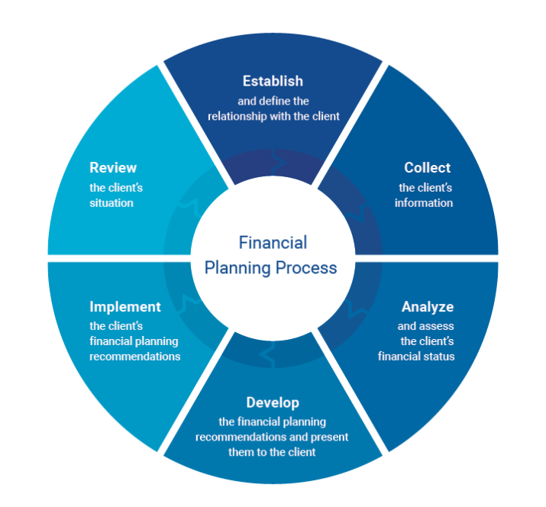
What is financial planning?
The financial planning process is a collaborative, iterative approach to managing your finances that considers multiple aspects of your financial situation to formulate strategies and make recommendations.

Slide 8
Code of Ethics
CFP professionals agree to adhere to FPSB’s Code of Ethics…
Client First. Place the client’s interests first
Integrity. Provide professional services with integrity
Objectivity. Provide professional services objectively
Fairness. Be fair and reasonable in all professional relationships. Disclose and manage conflicts of interest
Professionalism. Act in a manner that demonstrates exemplary professional conduct
Competence. Maintain the abilities, skills and knowledge necessary to provide professional services competently
Confidentiality. Protect the confidentiality of all client information
Diligence. Provide professional services diligently

Slide 9
Call to actions…
Join us in celebrating World Financial Planning Day on 9 October! Check out activities in your area and around the world at: https://worldfpday.org/global-events/.
Today, as we celebrate World Financial Planning Day, we encourage you to take charge of your financial future with the help of a financial planner. Connect with a CFP professional to begin your journey to financial freedom: <<Link to your CFP professional directory>>
‘Live your today, plan your tomorrow™’ by discovering how a financial plan can help you feel more confident and in control, stay on track with your goals, and balance the needs of today with your dreams for tomorrow. Learn more at worldfpday.org.
People who work with a financial planner report a better quality of life. Learn more about research with over 15,000 individuals in 15 territories on the value of financial planning and discover how financial planning can help you.
Today is World Financial Planning Day! Hear from key stakeholders in the global financial planning profession on the importance of financial planning. <<Link to WFPD chief executives video>>

